Slide 1
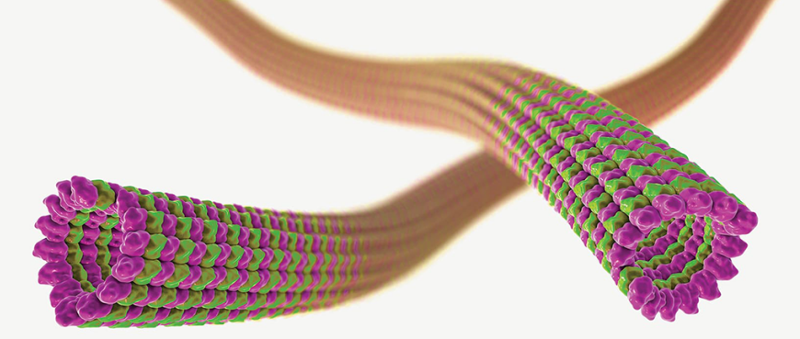


TubInTrain e-meeting
29-30th April 2020
^{Zoom Platform}
Organizing commitee:
Dr. Benedetta Santini, Project manager
Prof. Daniele Passarella, Università degli Studi di Milano
Thursday 30th April
2.30 pm: Welcome (Prof. Passarella)
2.45 pm: ”Dissecting the interaction of α-Synuclein with tubulin/microtubules.” Josine Kothuis
Supervisor: Prof. Cappelletti, Università degli Studi di Milano.
3.00 pm: ”Evaluation of the interaction of MAPs and small molecules with Tub and MTs. In cells evaluation.” Francesca Bonato
Supervisor: Prof. Diaz, Centro de Investigaciones Biológicas and Universidad Internacional Menéndez Pelayo.
3.15 pm: ”Impact of small molecules on neuronal microtubule (MT) assembly and MT dynamics by quantitative live cell imaging of model neurons.” Simone Attanasio
Supervisor: Prof. Brandt, University of Osnabrück.
3.30 pm: ”Impact of small molecules and peptides on Tau-MT interaction and tau aggregation in primary peripheral neurons and models of Alzheimer’s and Parkinson’s disease.” Ahmed Osama Abdelhamid Soliman
Supervisor: Prof. Brandt, University of Osnabrück.
3.45 pm: ”Systematic assessment of cell and metabolic impacts of Microtubule Targeting Agents (MTA) in neurodegeneration and neuron models.” Milo Basellini
Supervisor: Prof. Cascante, University of Barcelona.
4.00 pm: ”Development of metabolic modelling tools to determine vulnerabilities associated with the metabolic reprogramming induced by MTA therapies on neurodegeneration models and in silico prediction of metabolic targets.” Sai Prashanth
Supervisor: Prof. Cascante, University of Barcelona.
4.15 pm: Greetings
4.30 pm: Supervisory board meeting
Wednesday 29th April
2.30 pm: Welcome (Prof. Passarella)
2.45 pm: ”Computer aided molecular design and simulation of modulators of Tubulin-Tubulin and MAPs-Tubulin interactions.” Helena Perez Pena
Supervisor: Prof. Pieraccini, Università degli Studi di Milano.
3.00 pm: ”Molecular Modeling and Virtual Screening for Rational Design of Tubulin-Protein Interaction Modulators.” Maxim Shevelev
Supervisor: Prof. Varnek and Dr. Horvath, University of Strasbourg.
3.15 pm: ”Development of small molecules as MTs modulators acting on Tub-Tub interactions.” Zlata Boiarska
Supervisor: Prof. Passarella, Università degli Studi di Milano.
3.30 pm: ”Development of small molecules to modulate MT stability.” Anne Catherine Abel
Supervisor: Dr. Prota, University of Basel and Paul Scherrer Institute.
3.45 pm: ”Development of molecular probes acting on Tau/Tubulin and a-Synuclein/Tubulin interface.” Kalliroi Peqini
Supervisor: Prof. Pellegrino, Università degli Studi di Milano.
4.00 pm: ”Development of inhibitors of Tau aggregation” Davide Di Lorenzo
Supervisor: Prof. Ongeri, UPSaclay University.
4.15 pm: ”Development of inhibitors of α-Synuclein aggregation” Nicolò Bisi
Supervisor: Prof. Ongeri, UPSaclay University.
4.30 pm: Greetings

